Slide 1




Robot Arm Project
Sponsored by

Slide 2
Project Motivation
To build a sufficiently advanced, yet inexpensive robot arm
To get experience with robotics
To have fun

Slide 3
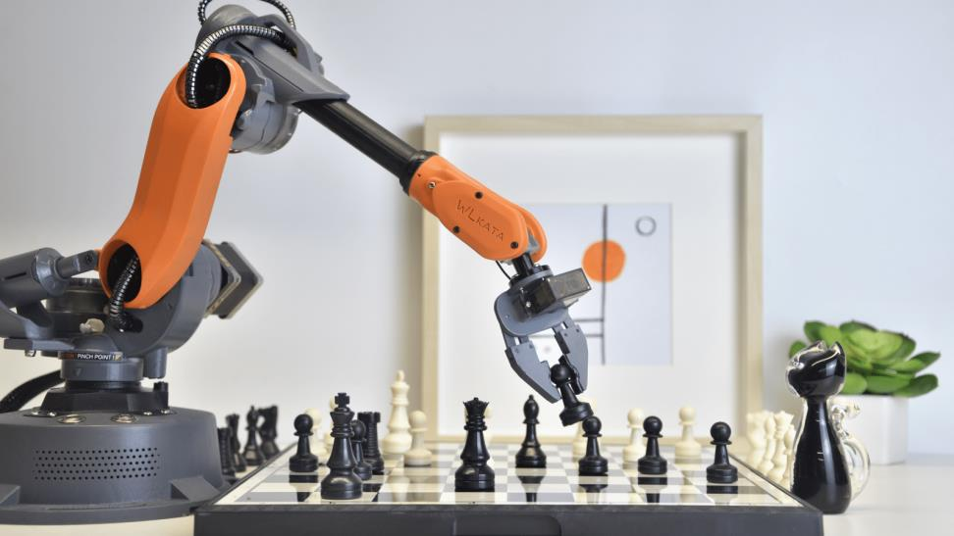
Project Goals
Program the arm to play chess against a human
Use a camera to detect the pieces
Pick and place the chess pieces accurately

Slide 4
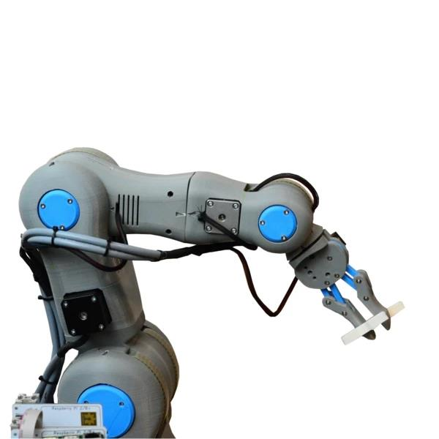
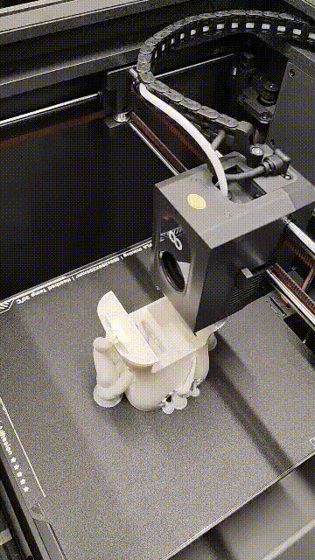
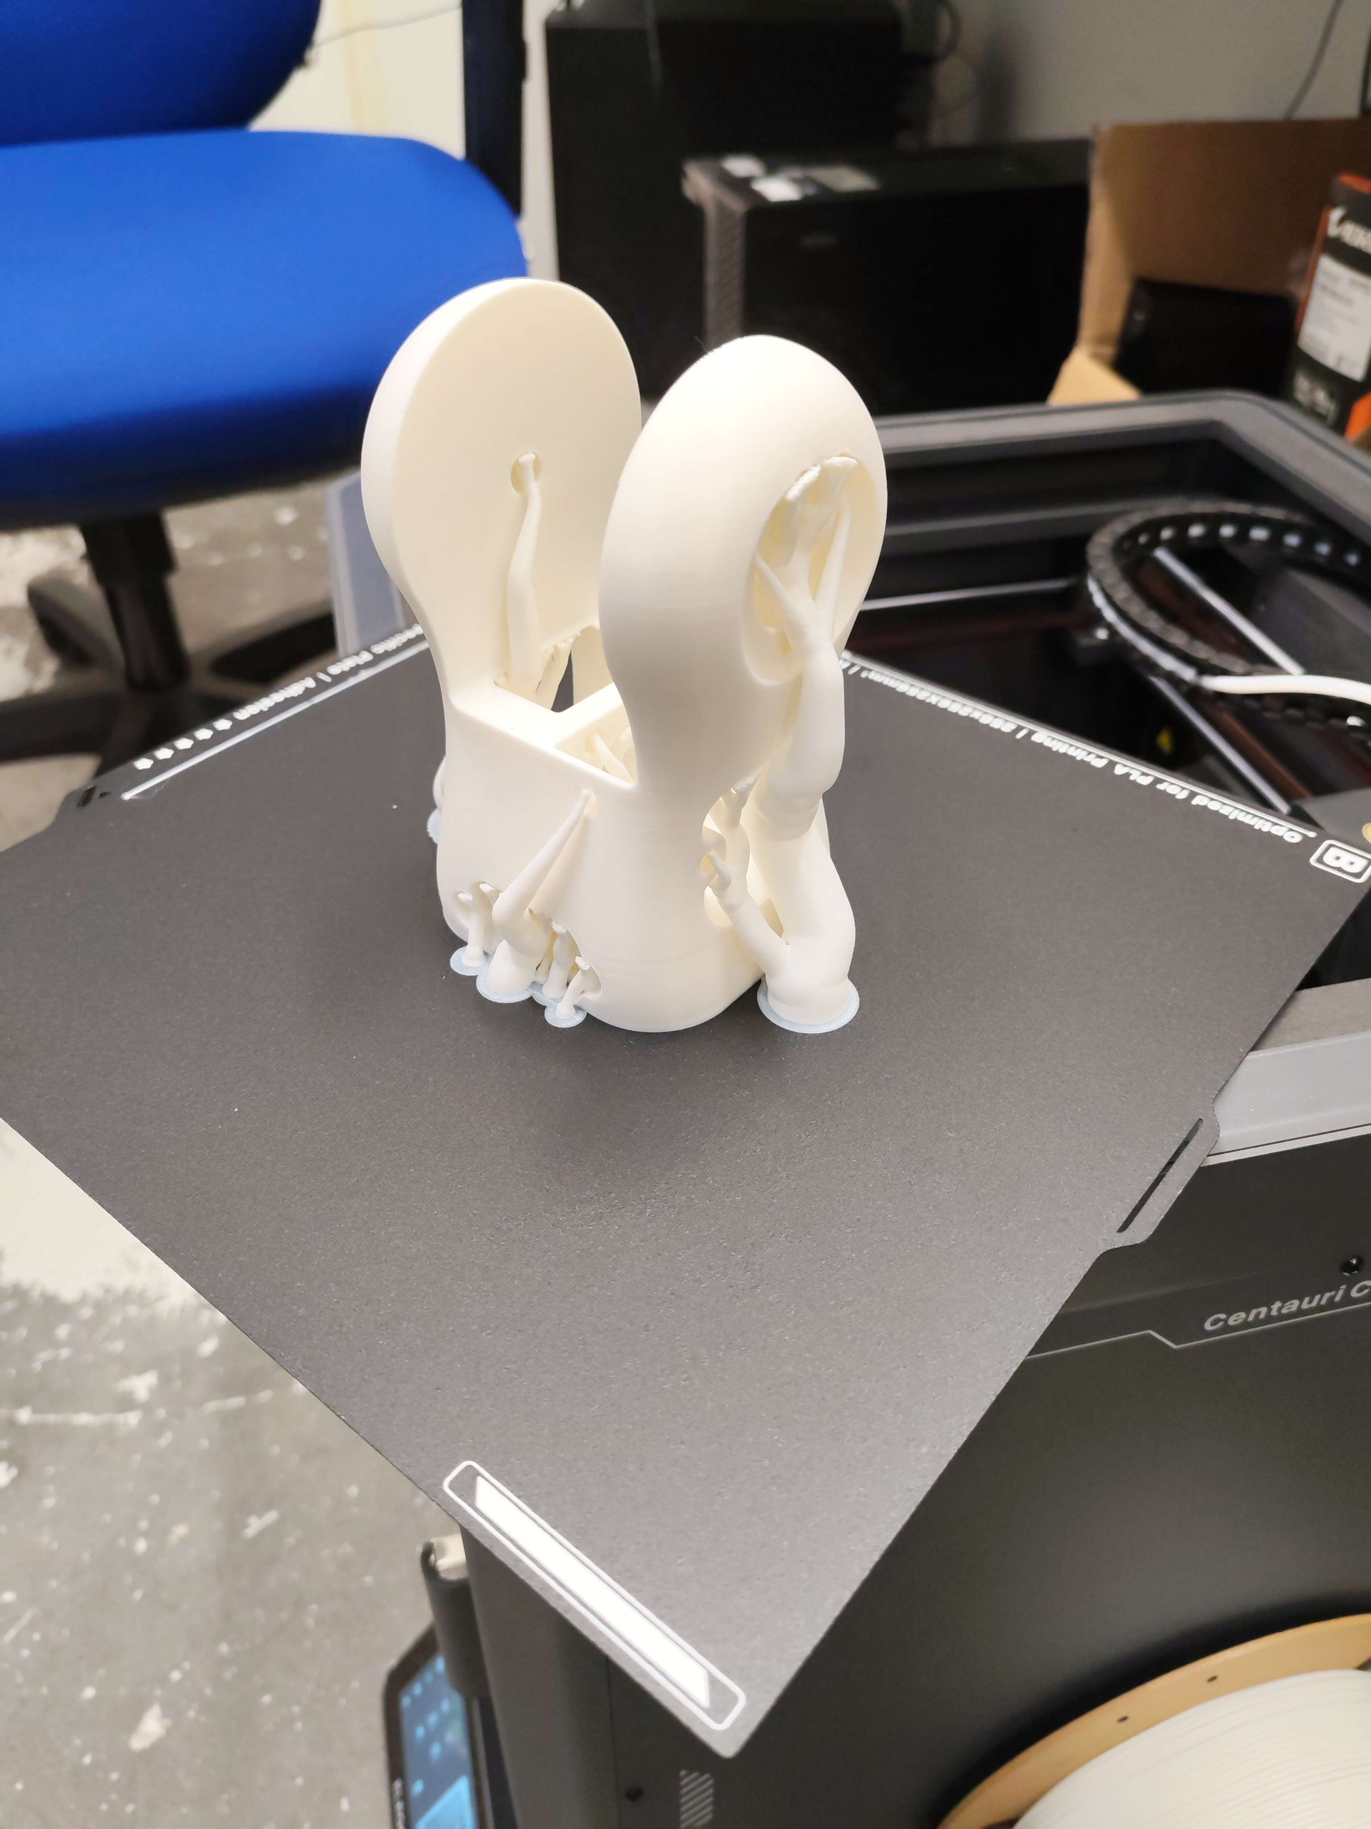
Hardware
Modifying RBX1 by Roboteurs

Slide 5



Main Focus: Software
Hardware is almost ready, so software will be the main focus
We will use ROS2, MoveIt, Python

Slide 6
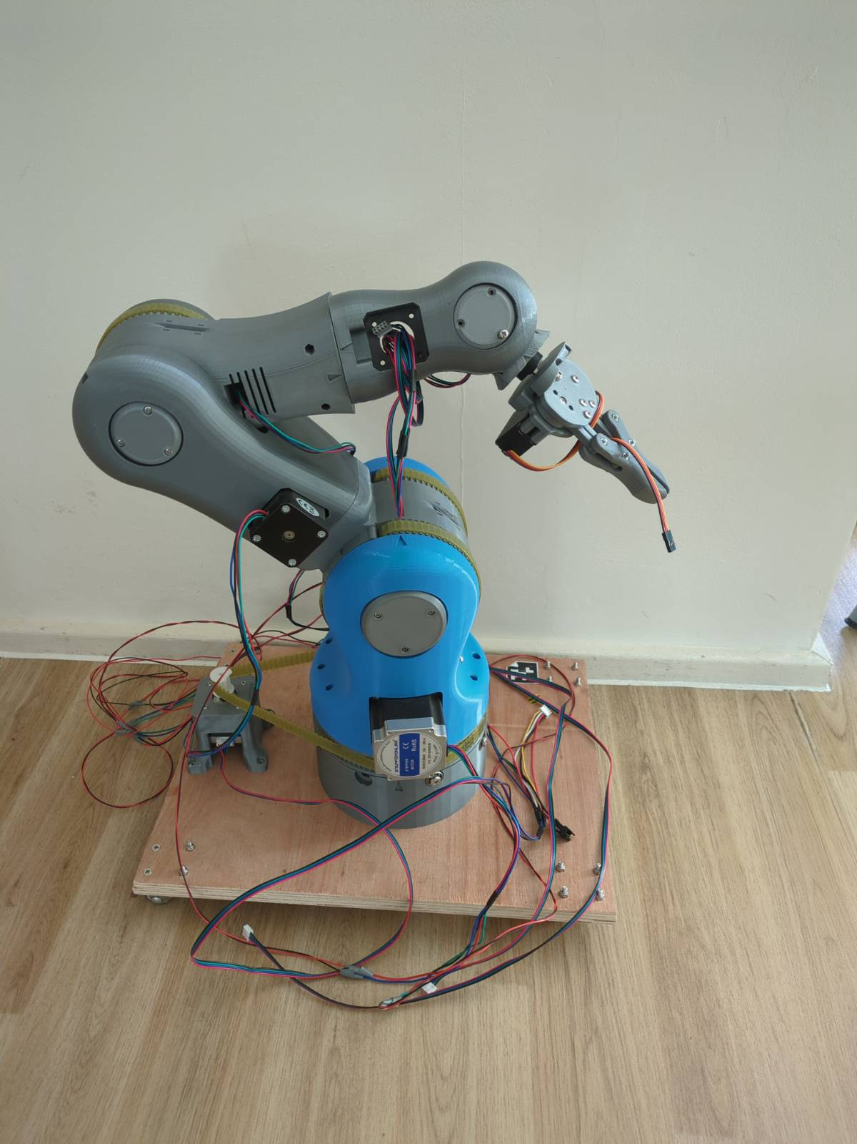
Tasks Completed
Built the first prototype of hardware
Robot arm motion
Chess piece detection
Chess board detection

Slide 7
Tasks Left
More intelligent motion planning
Task planning
Integration testing and debugging
Improvements to computer vision code

Slide 8
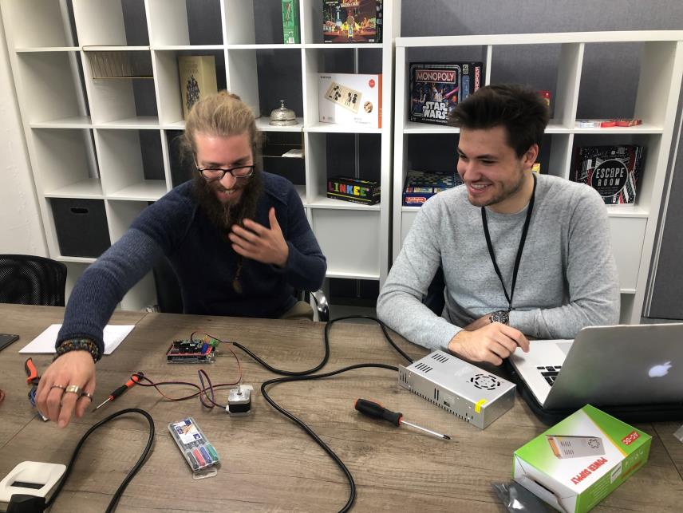
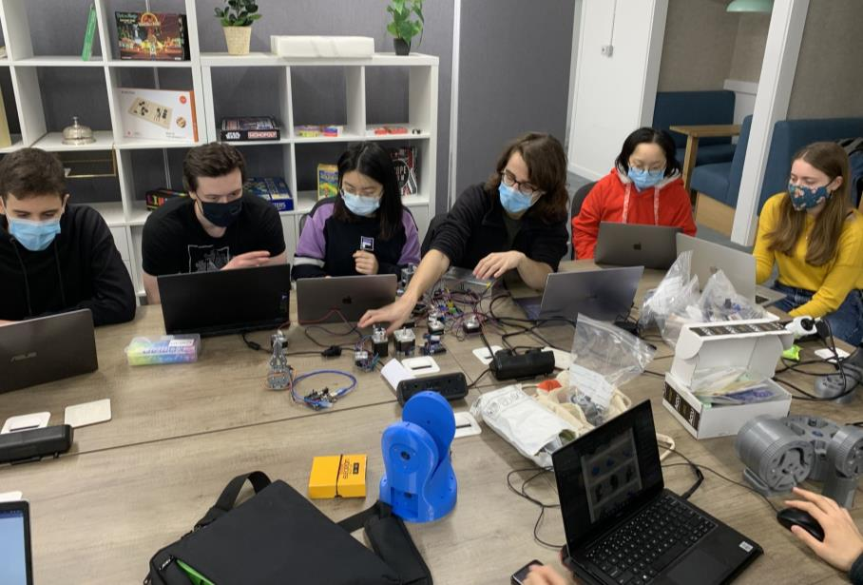
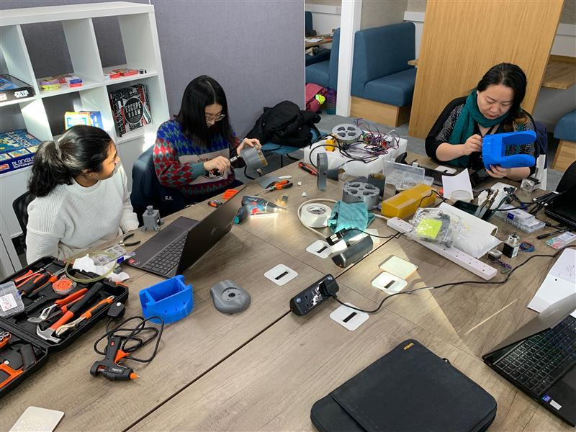
History

Slide 9
Plan
Introduction to ROS and setup
Introduction to OxARM code structure and subteams
Work on tasks in subteams
    Configure MoveIt to work with our design
    Connect MoveIt to the rest of the code
    Improve computer vision accuracy
Sessions on Sundays 10am-1pm

Slide 10
What you can learn
Experience with ROS and its common packages, the industry standard for robotics
Experience with Linux, 3D printing, Arduino
A medium through which you can meet like-minded people

Slide 11
Any Questions?

